Slide 1

K. K. Wagh Polytechnic, Nashik. Hirabai Haridas Vidyanagari, Amrutdham, Panchavati, Nashik-422003 Department of Computer Technology
‘‘
A Holistic Approach to Campus Recruitment and Student Profile Analysis for Placement
”
Guide name: Mr. S. H. Sangale
Group Members:
Kalyani Hemant Bangar
Aditya Arun Dhakane
Shraddha Punjaram Gaidhani
Ashwini Ashok Salunke
CP- 04

Slide 2
INTRODUCTION
The system is introduced to bridge the gap between education and the job market. It addresses challenges faced by students and employers during the transition from academic to the professional world.
The system uses data-driven analysis to create student profiles, helping students understand their strengths And employers identify suitable candidates efficiently.
It takes a holistic approach to recruitment, and placement emphasizing practical skills and industry readiness.
This system signifies a commitment to job-ready graduates and fostering collaboration among students, institutions, and employers.

Slide 3
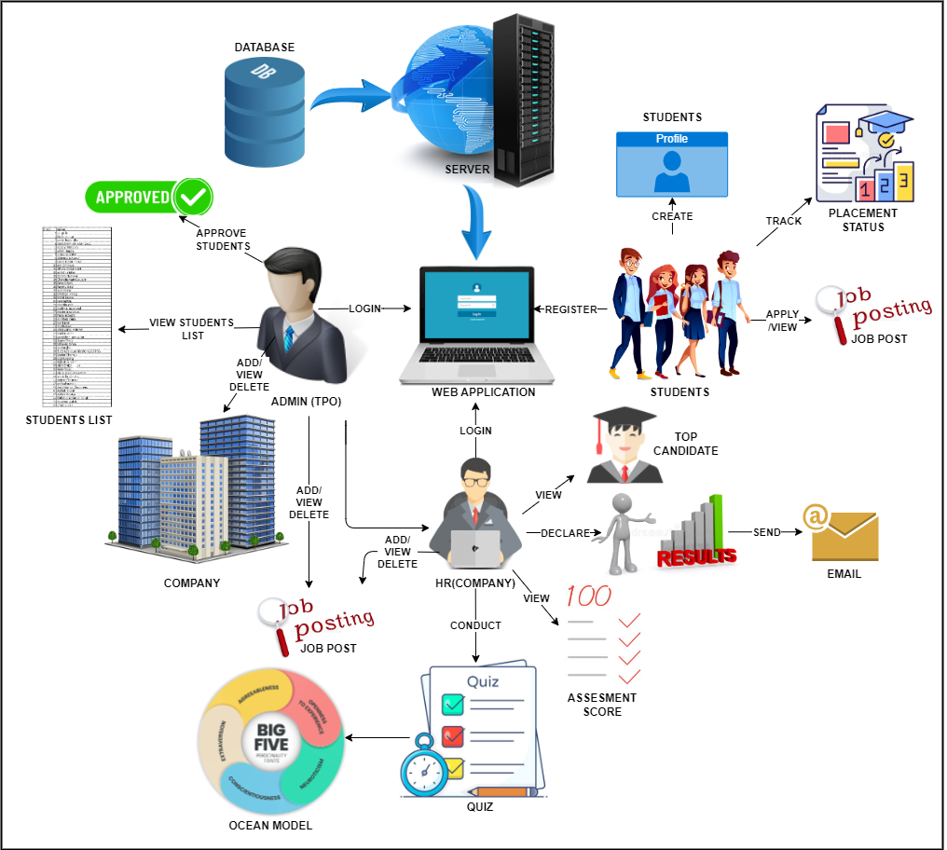
Project Design
Fig.1 System Architecture

Slide 4
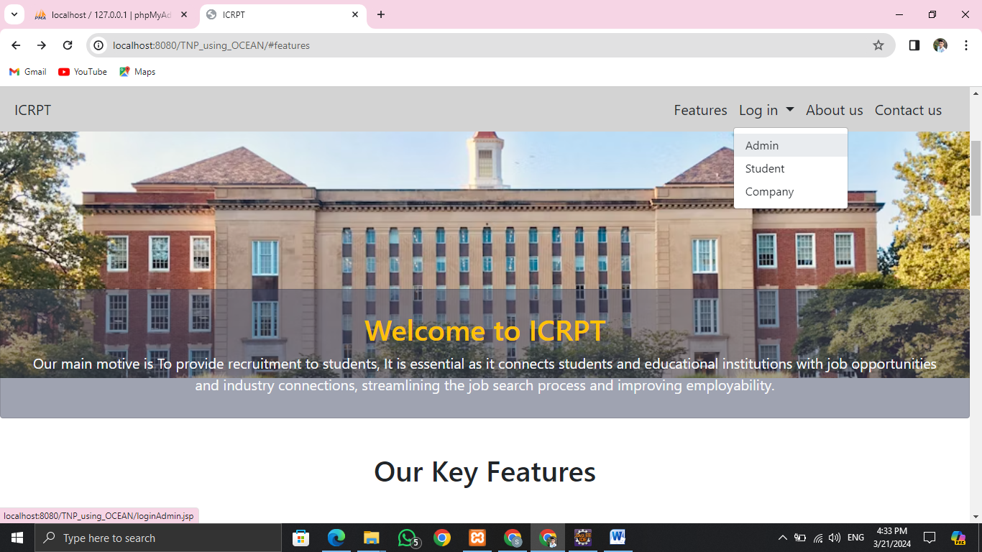
Working of module
Home Page
Main Module in the system:
Admin (TPO)
Student
Company (HR)

Slide 5
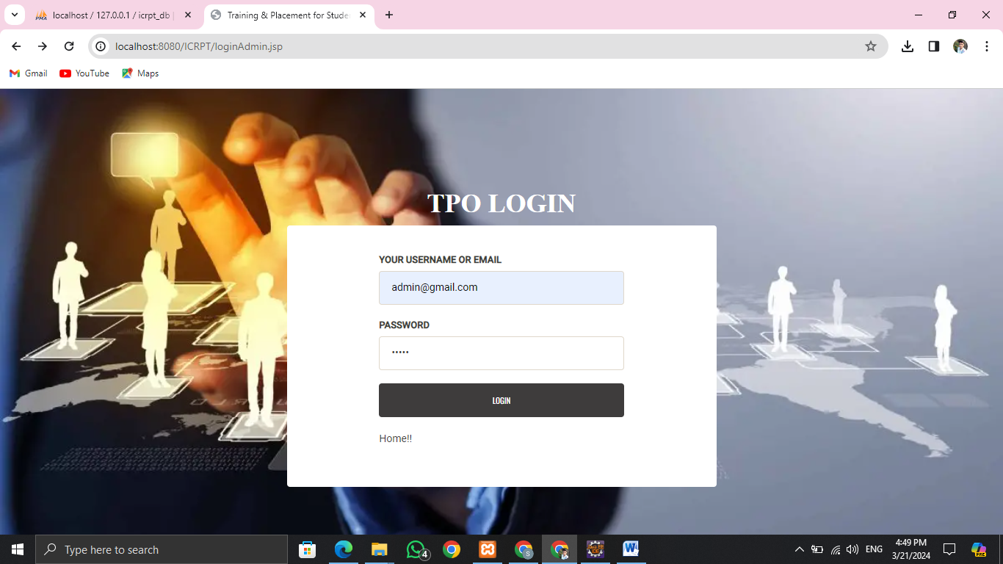
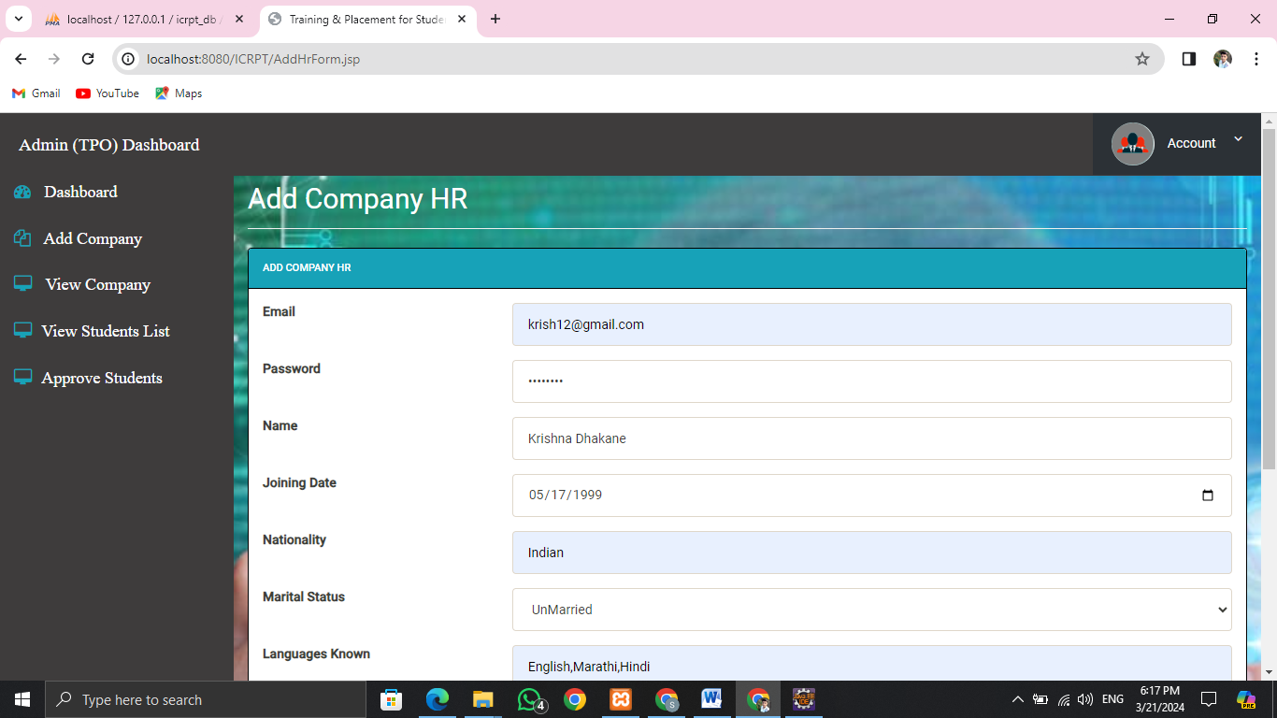
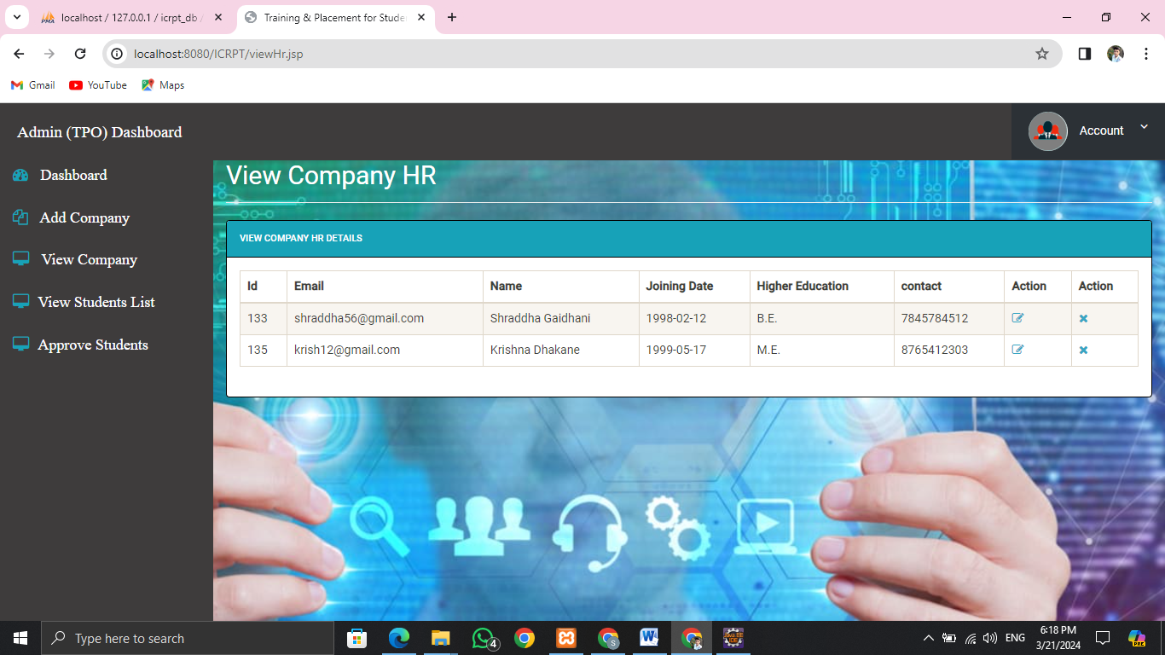
Working of Module: Admin (TPO)
TPO Login
Add Company
View Company list which are available

Slide 6
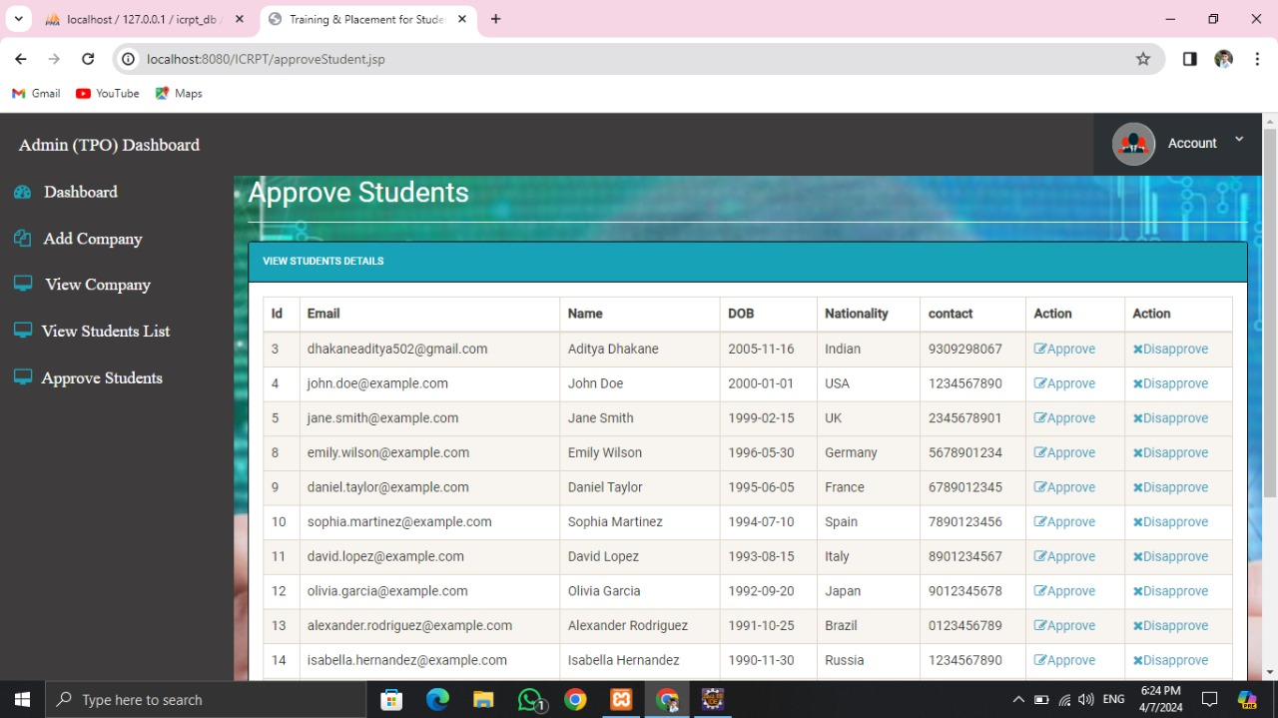
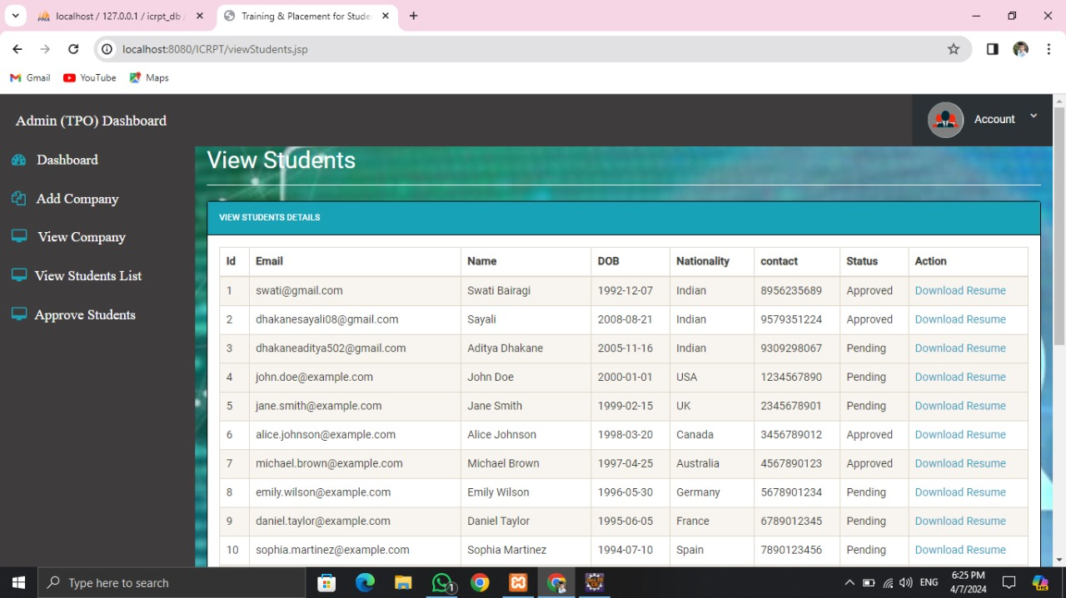
Working of Modules: Admin (TPO)
List of all Students interested in ICRPT
Student list to whether to Approve them or not

Slide 7
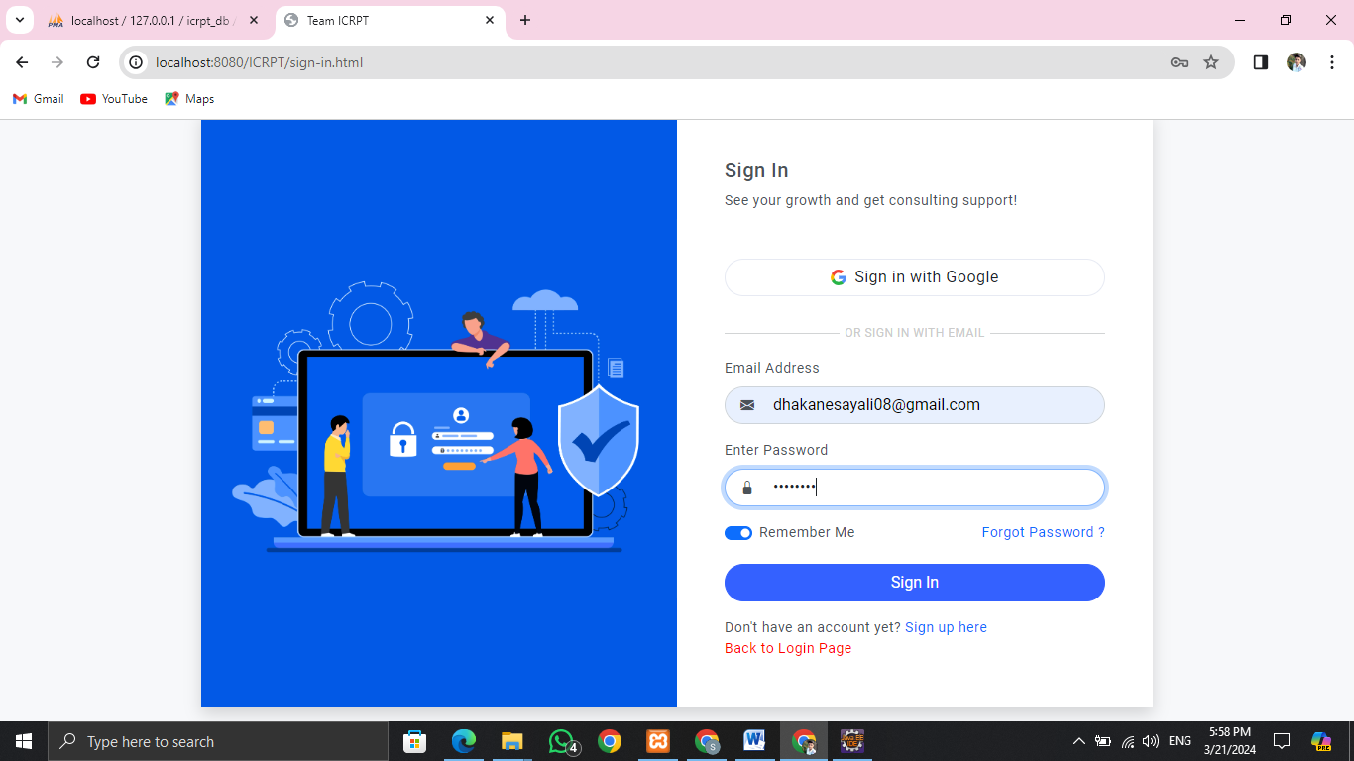
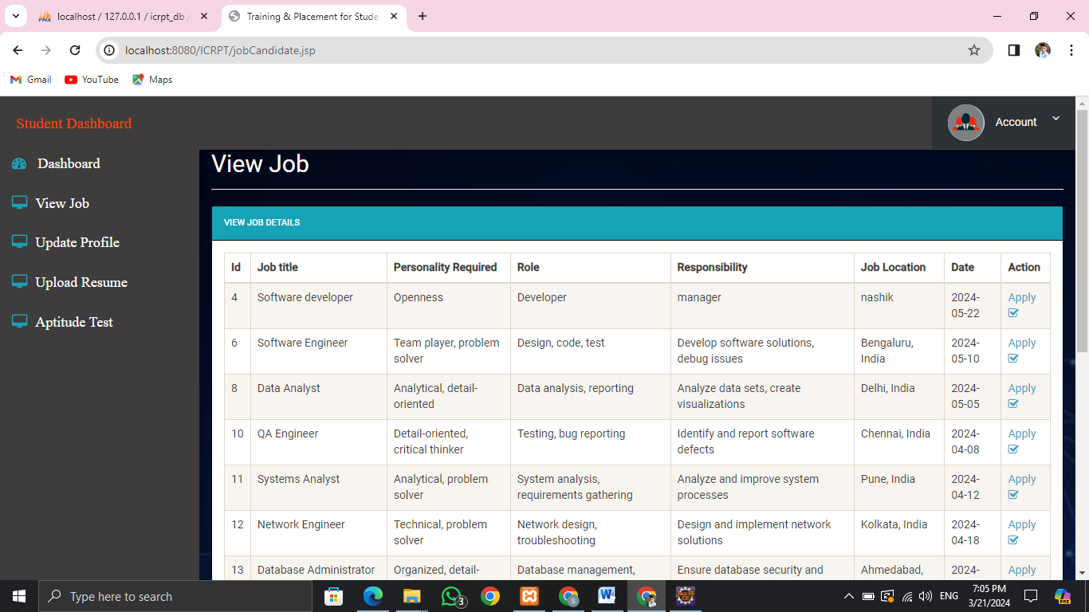
Working of Module: Student
Sign-In page which will redirect to student dashboard if the student is approved
View Jobs which are currently active

Slide 8
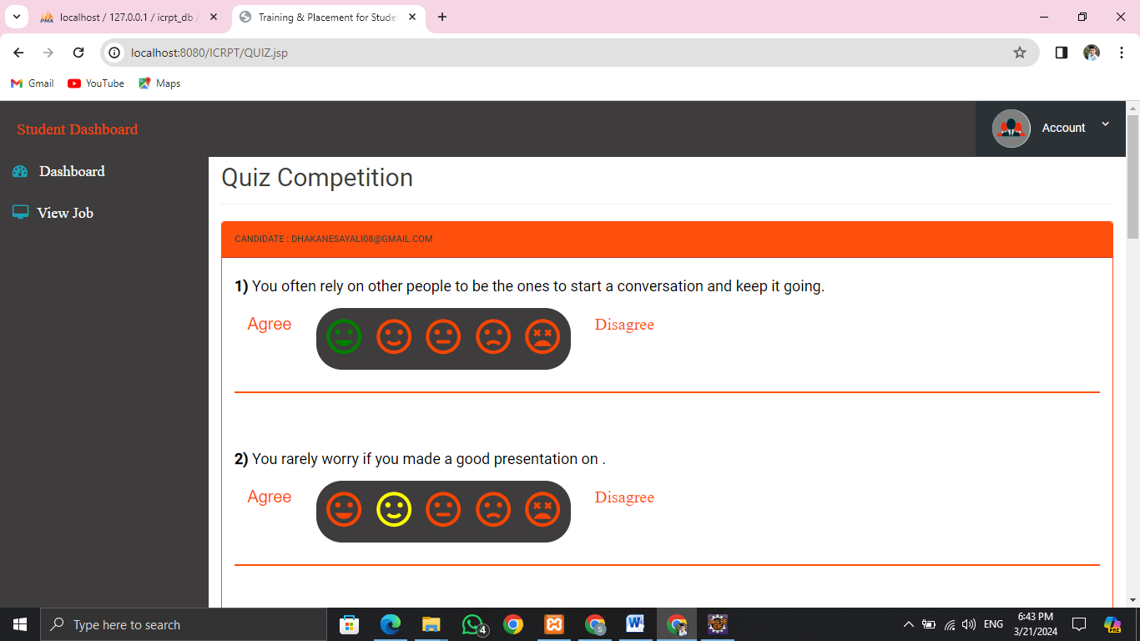
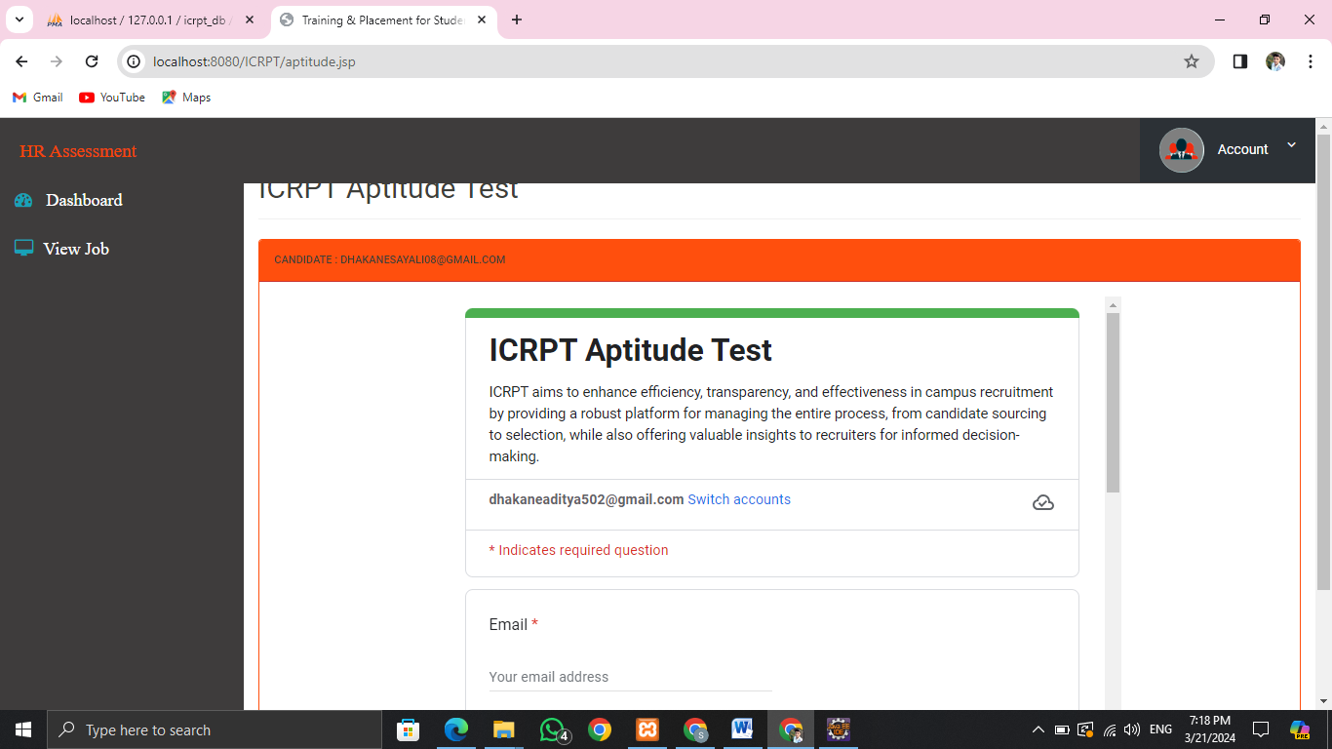
Working of Module: Student
When you apply for the job it will redirect to the Quiz
Based on the 5 big factor (10 question)
Result will be generated based on the 5 factors
Sample Aptitude test for Logical reasoning
For the Practice Purpose

Slide 9
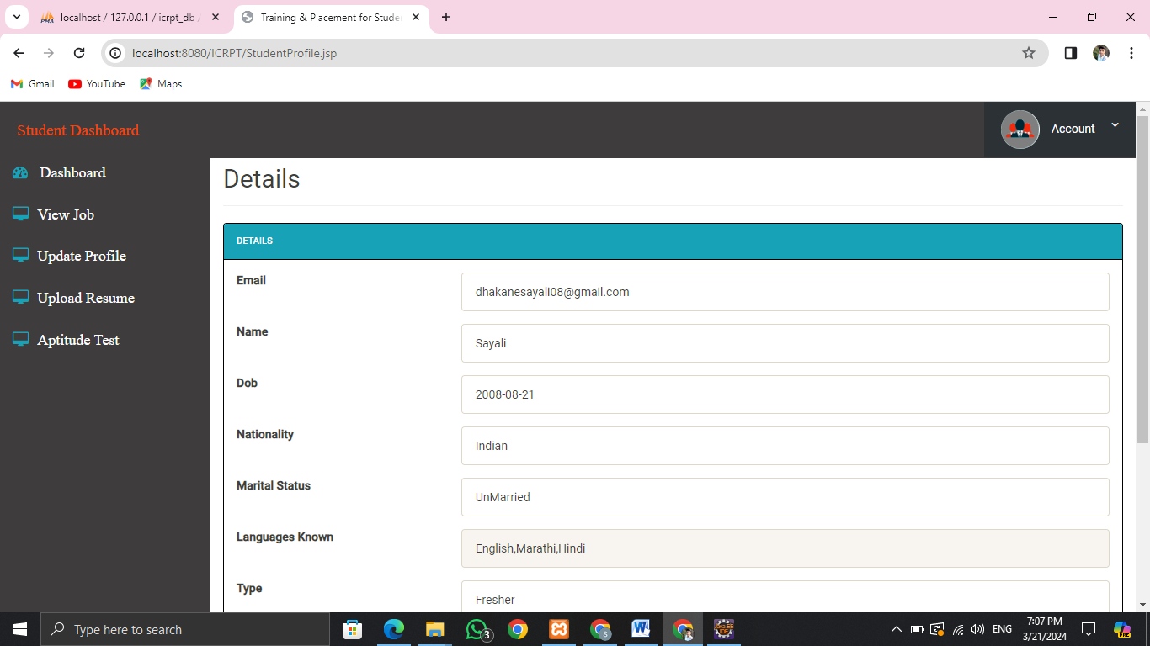
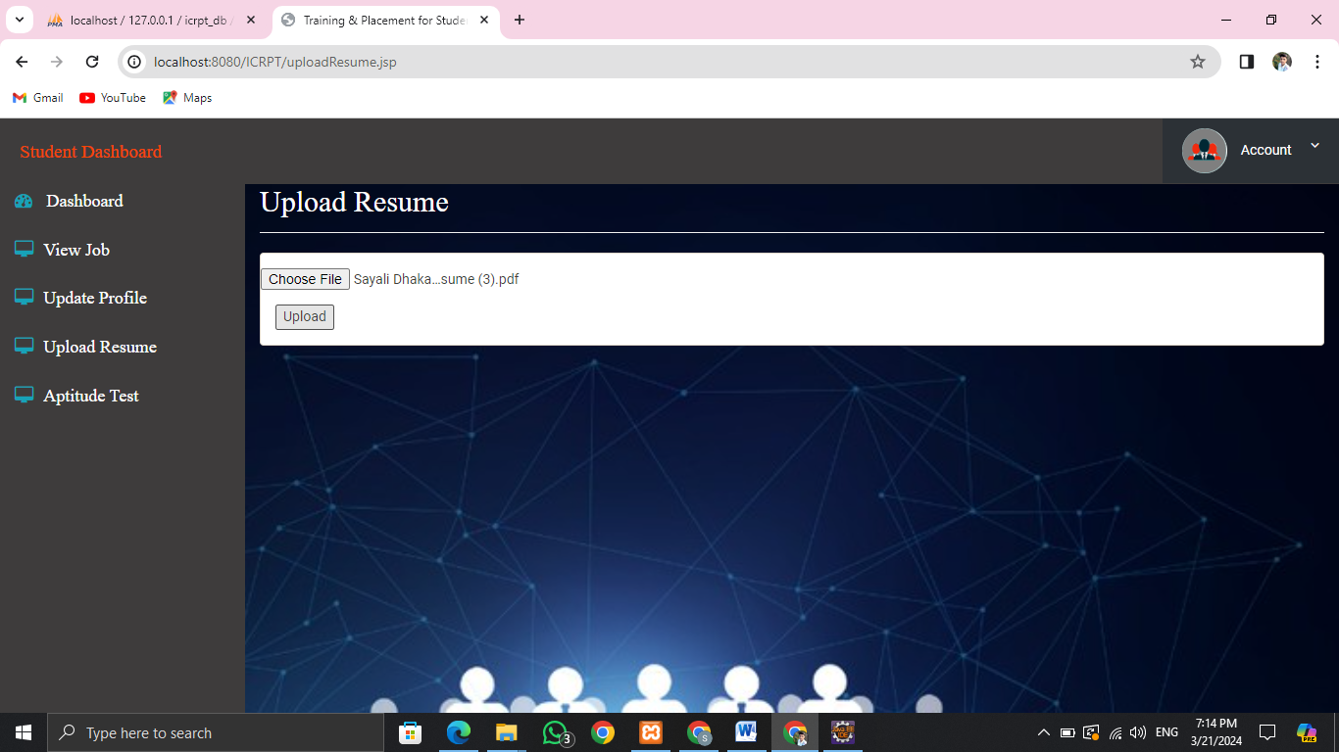
Working of Module: Student
To Update profile
Upload Resume as it is the main factor

Slide 10

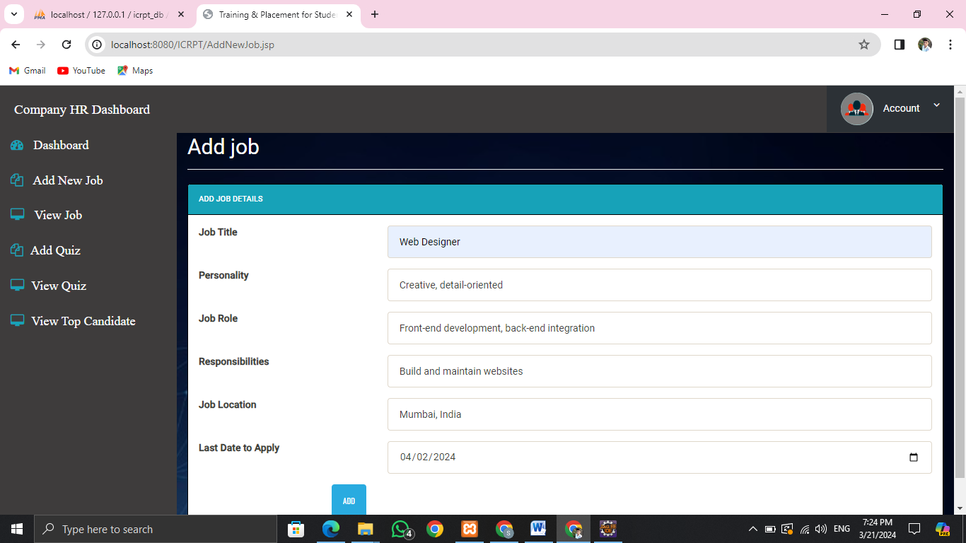
Working of Module: Company(HR)
HR Login
The HR will add Job Post and Enter the details for the Requirements of the Job

Slide 11


Working of Module: Company(HR)
View Jobs Which are posted by the Company
Add Quiz Based on the personality required for the Job

Slide 12
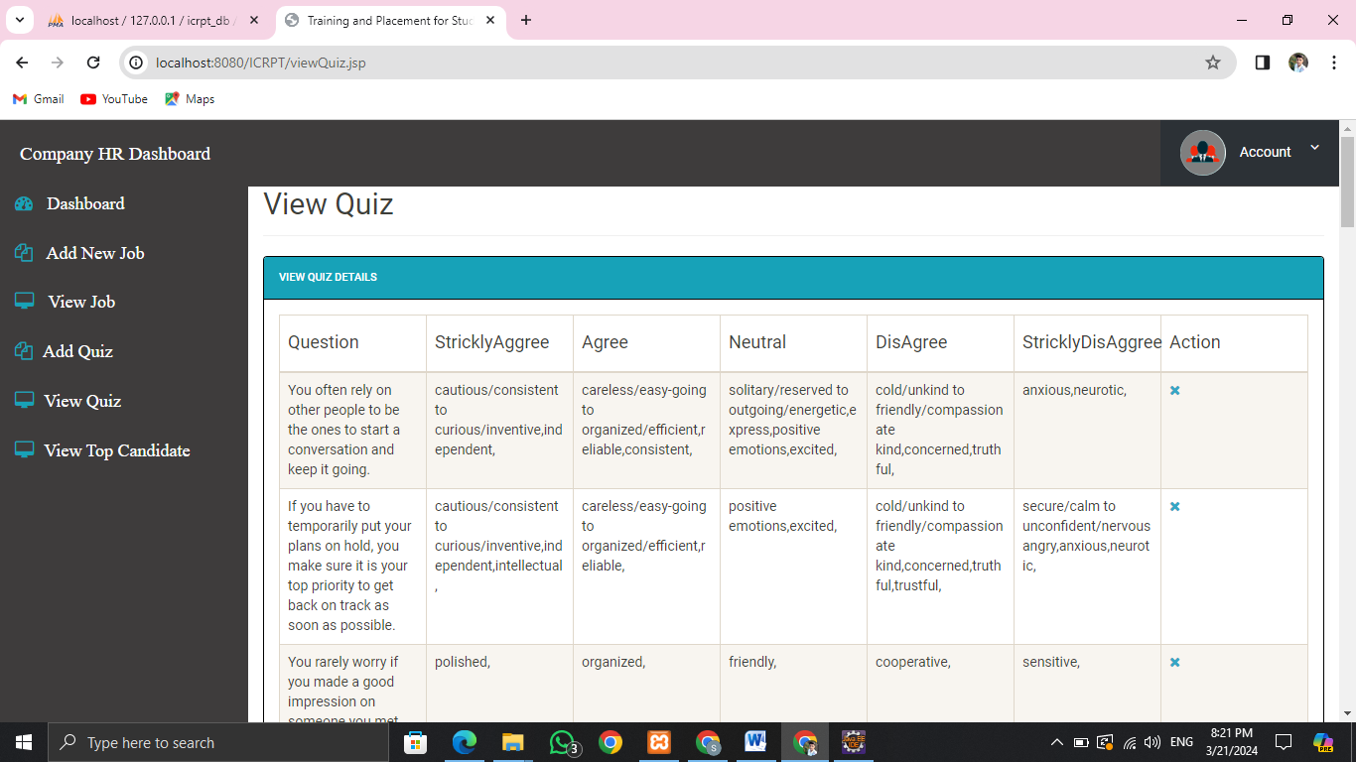
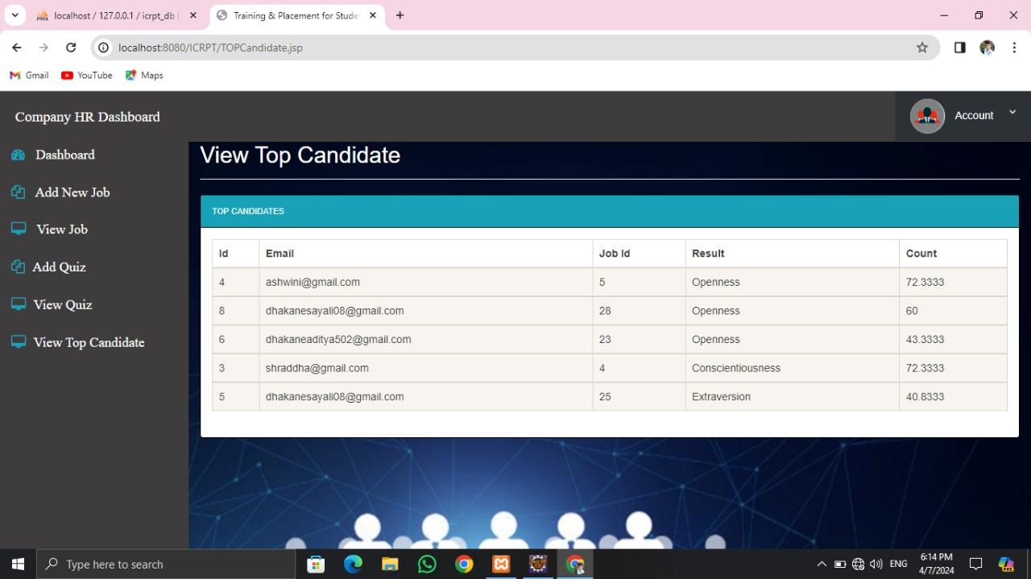
Working of Module: Company(HR)
Can View the design and structure of the Quiz which were added
Can View the Top Candidates and then the Top Candidates will only receive the Email

Slide 13
THANK YOU

